Slide 1

KIET GROUP OF INSTITUTIONS,GHAZIABAD
Department of Computer Science and Information Technology
Academic Year 2022-23

Slide 2
PROJECT TITLE :
CRICKET SCORE DISPLAY PROJECT
Member Involved
Name : Avinash Tiwari
Roll no. 2100290110041
Mentor :
Mr. Vinay Kumar
Mrs. Garima Singh
Miss Rhea Srivastava
Name : Ananya Singh
Roll no. 2100290110025
Name : Anurag Mishra
Roll no. 2100290110031

Slide 3
Content:
Introduction
Objective
Technology Used
Source Code and Output
Program Explaination
Application

Slide 4
Introduction:
The Cricket Score Sheet project is a simple application written in the C programming language. It employs file management to store data like as runs, wickets, overs, and extras, among other things. The application may show runs, wickets, batsman and bowler names, overs, extras, bowler economy, batsman strike rate, and so on. It also shows the game's start and end times. The source code is comprehensive, devoid of errors, and simple to comprehend.

Slide 5
Objective:
It provides separate data set of each player which helps to provide a better understanding about different layers in the match.
It helps to tabulate a series of different kinds of player such as man of the , match , series of the match, the highest scorer,etc.
It may be beneficial when our aim is choose a good player

Slide 6
Technology Used
Structure in C
File Handling
Some important concept Data structure and algorithm
Power-bi for graph representation in different ways

Slide 7
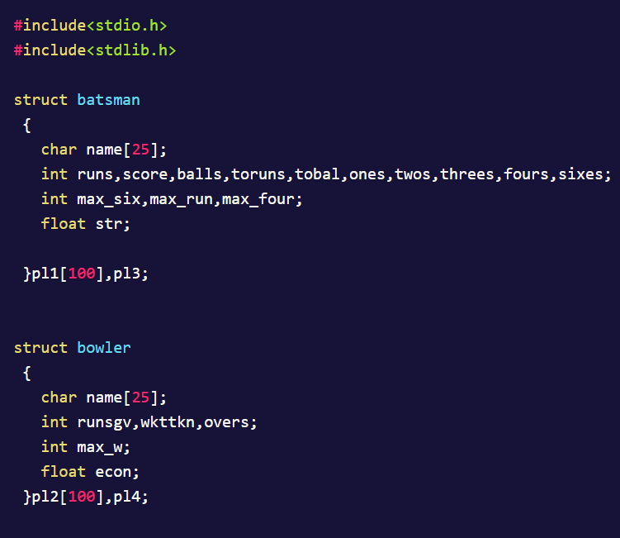
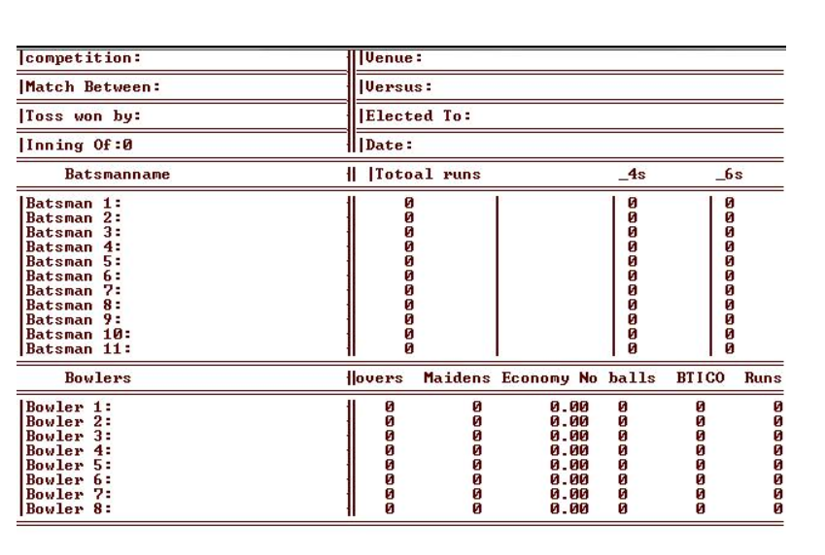
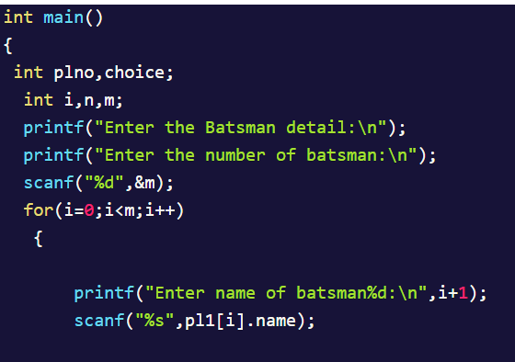
Source Code
Output of Program:

Slide 8
Program Working Explanation
The project begins by displaying the welcome screen, which fades up to reveal the main menu. There are three choices on the main menu:
Create a new score sheet
View a previous score sheet
Exit

Slide 9
Application
It is used in tournament.
It is used to compare the matches.
It helps to know the performance of different player in order to select some particular player for providing some award.

Slide 10
Thank You

